Slide 1


Cloud for AI
Course 2: Intro to MLOps
Filotas Theodosiou

Slide 2
First of all, any questions?

Slide 3
What did we learn in the first lecture

Slide 4
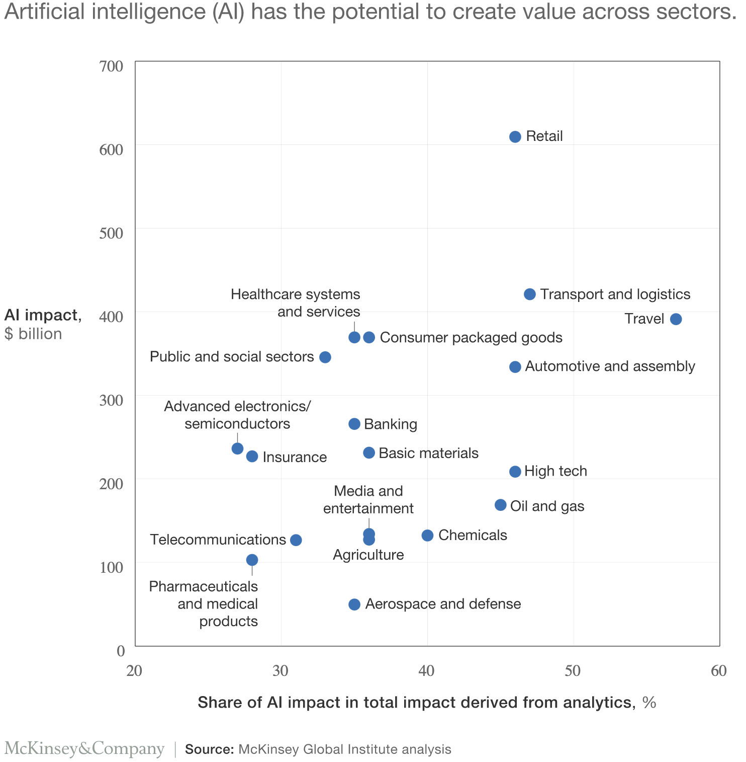
AI value creation by 2030
13 trillion USD
Most of it will be outside the consumer internet industry

Slide 5
Why ML Systems Design?
ML algorithms is the less problematic part
The hard part is to make algorithms work with other parts in order to solve real-world problems
Most failures in real-world applications are caused by non-ML components

Slide 6
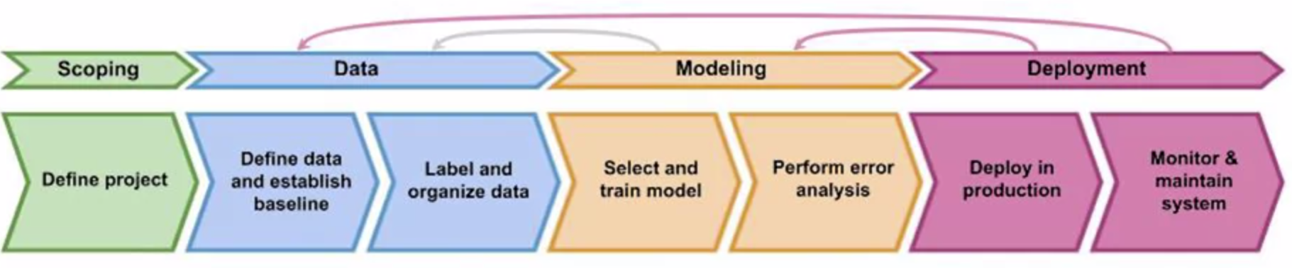
Introduction to MLOps
MLOps (Machine Learning Operations) is a set of practises for collaboration and communication between data scientists and operations professionals that aims to deploy and maintain Machine Learning models in production reliably and efficiently
Notes:
We will jump into this later in our course

Slide 7





Deployment Example
A complete ML system
Use computer vision on a production line to inspect if phones have defects
Detect scratches
Add a boundary box
How do you use this model in production?
Cloud server
Edge Device
Inspection Software
3
API
2
1
Prediction
Server
Camera
4
Control Software
Predict
ML model: F(X) => Y
5
Photo from a camera

Slide 8
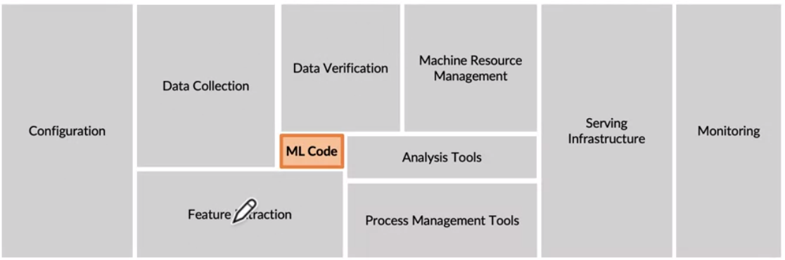
The requirements surrounding ML infrastructure
Requires the collaboration of different teams like Project Managers, Data Analysts, Data Engineers, Data scientists and ML engineers
D. Sculley et al NIPS 2015: Hidden Technical Dept in Machine Learning Systems
Notes:
Briefly describe each of these components

Slide 9
ML in research vs. in production
 | Research | Production
Objectives | Good Model Performance | Different Managers -> Different Objectives
Computational priority | Not this important. | Fast. Users should be happy.
Data | Static -> Fixed Dataset | Constantly changing (possibly daily)
Fairness | Good to have (sadly) | Important
Interpretability* | Good to have | Important

Slide 10
What are we going to talk about today

Slide 11
The lifecycle of a ML system
We are going to explain every stage step by step!

Slide 12

ML in production: expectation
Collect data
Train model
Deploy model

Slide 13
ML in production: reality
Choose a metric to optimize
Collect data
Train model
Realize many labels are wrong -> relabel data
Train model
Model performs poorly on one class -> collect more data for that class
Train model
Model performs poorly on most recent data -> collect more recent data
Train model
Deploy model
Dream about $$$
Wake up at 2am to complaints that model biases against one group -> revert to older version
Get more data, train more, do more testing
Deploy model
Pray
Model performs well but revenue decreasing
Cry
Choose a different metric
Start over
Step 15 and 17 are essential

Slide 14

Taxonomy of Data Disciplines: 2019
Data Scientist:
His role in our company:
Data Collection & Cleaning
Exploratory Data Analysis
Model Development
Prototype Deployment
Communication & Reporting

Slide 15



Taxonomy of Data Disciplines: 2024
Data Scientist
Business Understanding
Data Analysis for
Modelling
Talk to Customer
ML Engineer
Model Deployment
Model Scaling
System Integration
Monitor & Maintenance
Data Engineer
Data Collection & Storage
Ensure Data Quality
Build Data Pipelines

Slide 16
Taxonomy of Data Disciplines: 2024
MLops
Data Science
Science
ML Engineering
DataOps
Data Engineering
Engineering

Slide 17
Taxonomy of Data Disciplines: 2024
MLops
Data Science
Science
ML Engineering
DataOps
Data Engineering
Engineering

Slide 18
The Effectiveness of a Team
Nobody can do everything
Mix of skills is the best
Attention to detail and quality
Continuous learning

Slide 19
The Machine Learning project lifecycle

Slide 20
The Machine Learning project lifecycle
Scoping: Define the project and/or decide what you want to work on
Notes:
Check how he says it on week 1: Steps of an ML project to build your notes here.

Slide 21
The Machine Learning project lifecycle
Scoping: Define the project and/or decide what you want to work on
Data: Collect or acquire the data you need for the algorithm
Notes:
Check how he says it on week 1: Steps of an ML project to build your notes here.

Slide 22
The Machine Learning project lifecycle
Scoping: Define the project and/or decide what you want to work on
Data: Collect or acquire the data you need for the algorithm
Modelling: Train the model and perform error analysis.
Note: This is an iterative task
Notes:
Check how he says it on week 1: Steps of an ML project to build your notes here.

Slide 23
The Machine Learning project lifecycle
Scoping: Define the project and/or decide what you want to work on
Data: Collect or acquire the data you need for the algorithm
Modelling: Train the model and perform error analysis.
Note: This is an iterative task
Deployment: Deploy the system with a software in production and maintain it.
Note: This is an iterative task
Notes:
Check how he says it on week 1: Steps of an ML project to build your notes here.

Slide 24
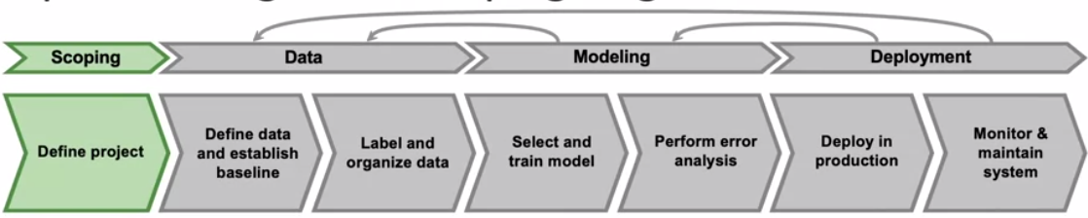
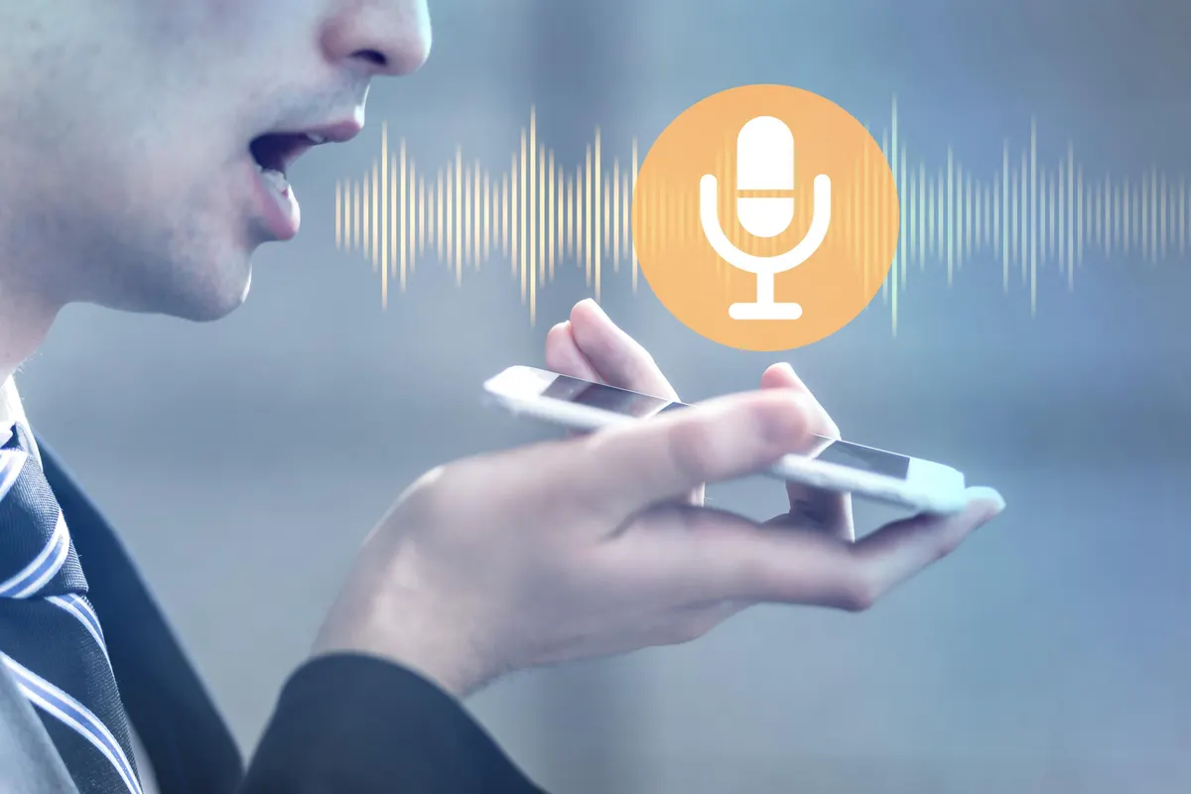
A Case Study: Speech recognition
Scoping stage
Decide to work on the speech recognition task for voice search & classification
Decide on the key metrics
Note: Metrics might be different compared to a normal data science project
Accuracy, latency, revenue
Estimate resources and timeline

Slide 25
Project objectives
ML objectives
Performance (accuracy)
Latency
etc.

Slide 26
Project objectives
ML objectives
Performance
Latency
etc.
Business objectives
Cost
ROI (Return on Investment)
Regulation & compliance

Slide 27
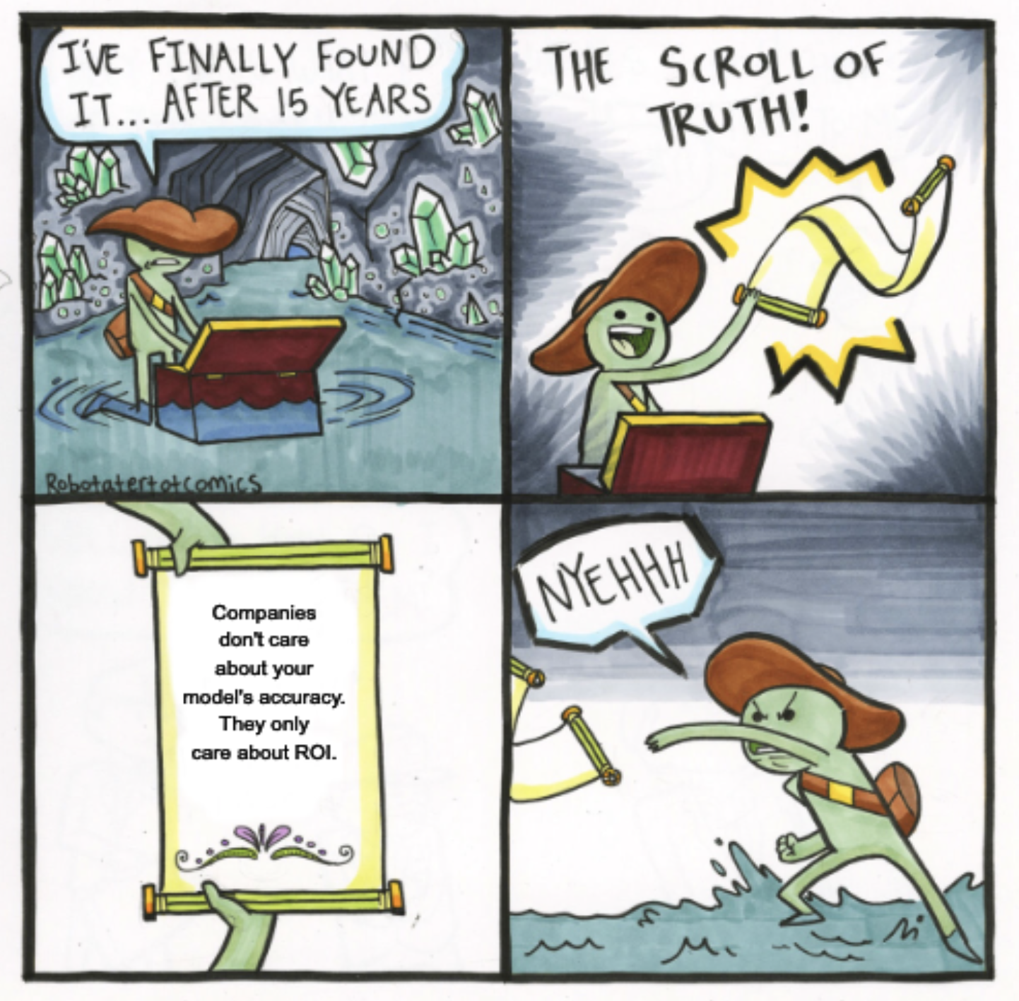
Project objectives
ML objectives
Performance
Latency
etc.
Business objectives
Cost
ROI (Return on Investment)
Regulation & compliance

Slide 28
Business objectives
How can this ML project increase profits directly or indirectly?
Directly: increasing sales (ads, conversion rates), cutting costs
Indirectly: increasing customer satisfaction, increasing time spent on a website
This should be carefully defined in project scoping!!!

Slide 29
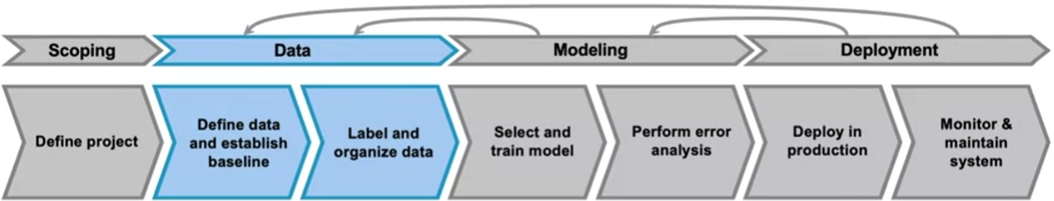
A Case Study: Speech recognition
Data Stage
Define data needs and start collecting
Is the data labeled consistently?
How much silence before/after each clip?
100ms? 300ms? 500ms?
How to normalize the volume?
Other people speak louder than others
How to label properly?
Hey, today's weather
Hey… today's weather.
Hey, today's weather?
Notes:
You spell with a right pronanciation

Slide 30
Data sources
User generated
Systems generated
Internal databases: users, inventory, customer relationships
Third-party data

Slide 31
Data sources
User generated
Systems generated
Internal databases: users, inventory, customer relationships
Third-party data
Users generated data | Systems generated data
User inputs or actions (click on button) | Logs, metadata, predictions
Easily mal-formatted | Easier to standardize
Need to be processed ASAP | OK to process periodically (unless to detect problems ASAP)

Slide 32
Data Engineering Pipelines
ETL (Extract, Transform, Load)
Raw Data in
User Data
System Data
Other
Clean Data Out
For:
Predictions
Modelling
Extract,
Transform,
Load
Transform
cleaning, validating, transposing, deriving values, joining from multiple sources, deduplicating, splitting, aggregating, etc.

Slide 33
Data Sources
User generated
Examples: User inputs, click actions on a website or app
Challenges: Data can be messy or incomplete
Note: Its important to be processed quickly (usually on the fly)
Systems generated
Examples: Logs, metadata, predictions from a system
Challenges: Easier to clean/organize
Note: Can be processed in batches
Internal databases: users, inventory, customer relationships
Third-party data

Slide 34
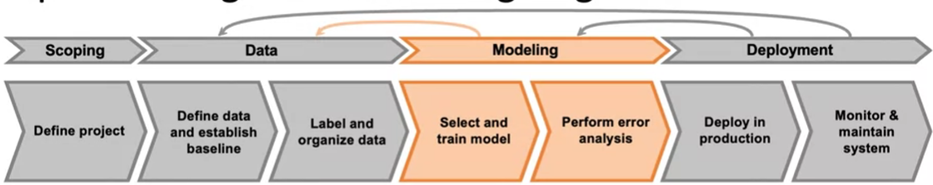
A Case Study: Speech recognition
Modelling Stage
Code (algorithm/model)
Hyperparameters
Data
ML Model
Notes:
We will talk about this later in more detail

Slide 35
A Case Study: Speech recognition
Modelling Stage
Code (algorithm/model)
Hyperparameters
Data
Research/Academia
ML Model
Notes:
We will talk about this later in more detail

Slide 36
A Case Study: Speech recognition
Modelling Stage
Code (algorithm/model)
Hyperparameters
Data
Research/Academia
ML engineers
ML Model
Notes:
We will talk about this later in more detail

Slide 37
A Case Study: Speech recognition
Modelling Stage
Code (algorithm/model)
Hyperparameters
Data
Research/Academia
ML engineers
ML Model
ML System = Code + Data
Notes:
We will talk about this later in more detail

Slide 38
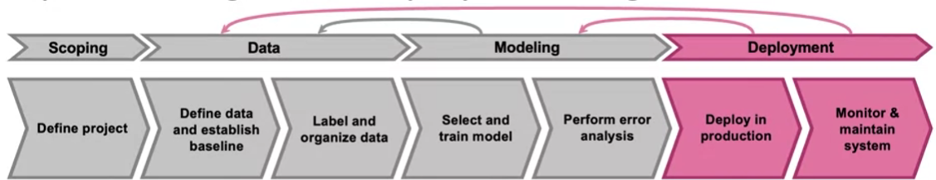
A Case Study: Speech recognition
Mobile Phone (Edge Device)
Local Software
Speech API
Voice
Detection and
Classification
VAD
Module
Microphone
Prediction
Server
Transcript
Classification
Frontend Code
Notes:
We will talk about this later in more detail

Slide 39
MLOps Challenges

Slide 40
Concept Drift and Data Drift
Data Drift:
When the distribution of the data used for predictions shifts from the data used to train the model during data collection or data processing
Example: Lighting conditions on the phone factory or update to the speech reading software.

Slide 41
Concept Drift and Data Drift
Data Drift:
When the distribution of the data used for predictions shifts from the data used to train the model during data collection or data processing
Example: Lighting conditions on the phone factory or update to the speech reading software.
Concept Drift:
When the distribution of data used for predictions shifts from the data used to train the model due to external factors
Example: Data during and after the pandemic
Changes can be either gradual or it can due to a sudden shock.

Slide 42
Software engineering issues
Checklist of questions to answer
Realtime or Batch?
Cloud vs Edge/Browser?
Computer resources (CPU/GPU/Memory)
Latency issues?
Logging
Security and privacy
Prediction
Service
X
y

Slide 43
First deployment vs maintenance
Software
Issues
Concept Drift
Data Drift
It is a non-stop iterative process

Slide 44
Deployment Patterns

Slide 45
When Should we Deploy? Common Deployment Cases
Vary based on a company’s maturity
New product/capability:
Offering a new service you have not provided before
Automate/assist with manual task:
Assist or Automate a task previously done by a person
Replace previous ML system
Replace a previous implementation of a machine learning system
Notes:
Week 1: Deployment -> deployment patterns

Slide 46
When Should we Deploy? Common Deployment Cases
Vary based on a company’s maturity
New product/capability:
Offering a new service you have not provided before
Automate/assist with manual task:
Assist or Automate a task previously done by a person
Replace previous ML system
Replace a previous implementation of a machine learning system
Key Ideas:
Gradual Ramp up with monitoring: Step by step deployment. First ensure everything works
Rollbacks: Keep previous versions of the product in case something goes wrong
Notes:
Week 1: Deployment -> deployment patterns

Slide 47
Degrees of Automation
Human
Yes No ?
Human
AI
Human
Only
Shadow
Mode
AI
Assistance
Partial
Automation
Full
Automation
Human in the loop

Slide 48
Monitoring

Slide 49
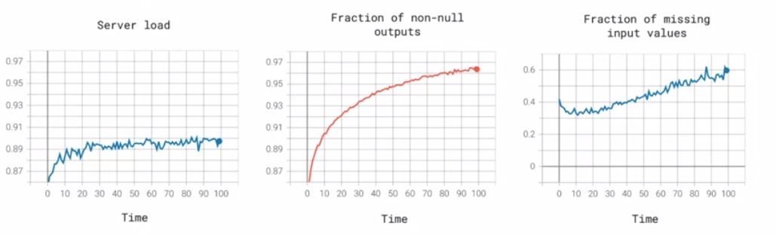
Monitoring Dashboard
Find all the things that can go wrong. Then monitor them :)
Think of statistics/metrics that will detect the problem before happening
Its better to use many metrics and then narrow them down instead of not having enough for all problems

Slide 50
Examples of Metrics to Follow
Software Metrics
Memory, compute, latency, server load
Avg input length
Avg input volume
Num of missing values
Avg image brightness
Input Metrics
Num of “ “ (Null) returns
Num of time user does re-search
Output Metrics

Slide 51
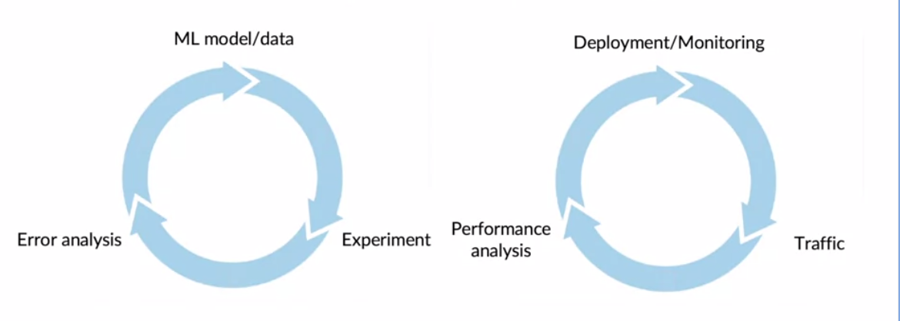
Like ML modelling, deployment is also iterative

Slide 52
ML Systems Architecture Example 1
You work in a big Taxi Company called MUBER.
The stakeholders wants to make ride times more consistent and understand longer journeys in order to improve the customer experience and thereby, increase return business

Slide 53
ML Systems Architecture Example 1
You work in a big Taxi Company called MUBER.
The stakeholders wants to make ride times more consistent and understand longer journeys in order to improve the customer experience and thereby, increase return business
Taxi Data
Data Store
Clustering
Database

Slide 54
ML Systems Architecture Example 2
You work for the logistics arm of a large retail chain.
To maximize the flow of goods, the company wants to get ahead of busy periods and avoid product sell-outs. It is agreed that planner will make requests for forecasts and access them from a web-hosted dashboard.

Slide 55

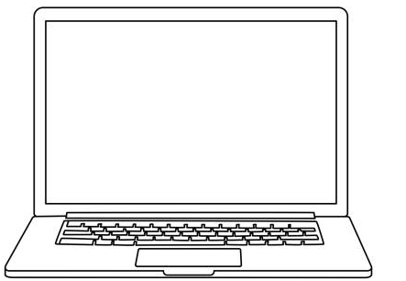
ML Systems Architecture Example 2
You work for the logistics arm of a large retail chain.
To maximize the flow of goods, the company wants to get ahead of busy periods and avoid product sell-outs. It is agreed that planner will make requests for forecasts and access them from a web-hosted dashboard.
Consumption Data
Web End Point
Data Store
Forecast
App Storage

Slide 56
Thats all for today :)

